Slide 1

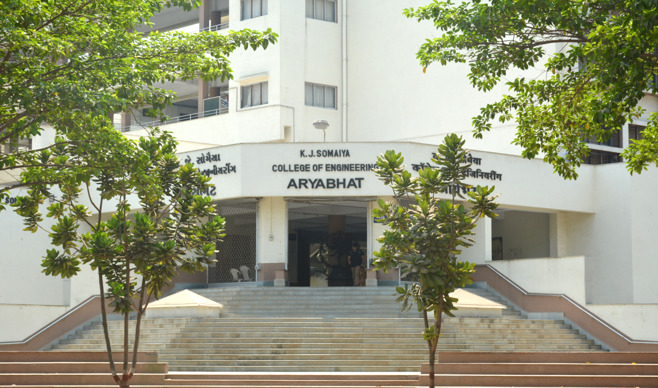
CareerVault: How We Fixed the 4 Evaluation Points
Aaryan Sharma · Aditya Baheti · Anamay Narkar · Anuj Madke
LY Project Evaluation · K J Somaiya School of Engineering
Notes:
Good morning. Last time you gave us four points. Today we show each one is fixed and running live.

Slide 2
Your 4 points, and what we did
1
Before: Records depended on our server
Now: Employee gets a proof file. Anyone can verify it without our server.
FIXED
2
Before: Database stored plain text
Now: Sensitive columns are encrypted (AES-256) before they are saved.
FIXED
3
Before: Blockchain was only simulated
Now: Real smart contract on Polygon Amoy. Real transactions on PolygonScan.
FIXED
4
Before: Explain the hashing exactly
Now: Fixed 5 steps: JCS → salt → SHA-256 → RSA signatures → Merkle root.
FIXED
Notes:
Read the four cards left to right, top to bottom. Each one is fixed and live on the deployed site. The next slides show each one with real screenshots, then we demo it live.

Slide 3
How CareerVault works (one document, start to end)
Holder
Asks TechCorp for an experience letter
Manager
Fills in the details and signs
HR
Checks and approves
Admin
Clicks "Anchor now"
Anyone
Verifies the document
Only a request is saved
Hash + 1st RSA signature
2nd RSA signature · Issued
Merkle root → Polygon
6 checks · no login
Two rules: sensitive data is always encrypted in the database, and only a 32-byte Merkle root ever goes on the blockchain.
Notes:
One document goes through five people or steps. Alice asks, Marcus fills and signs, Hannah approves and signs, the admin anchors it on the blockchain, and anyone can verify it. Everything sensitive is encrypted in the database at every step.

Slide 4
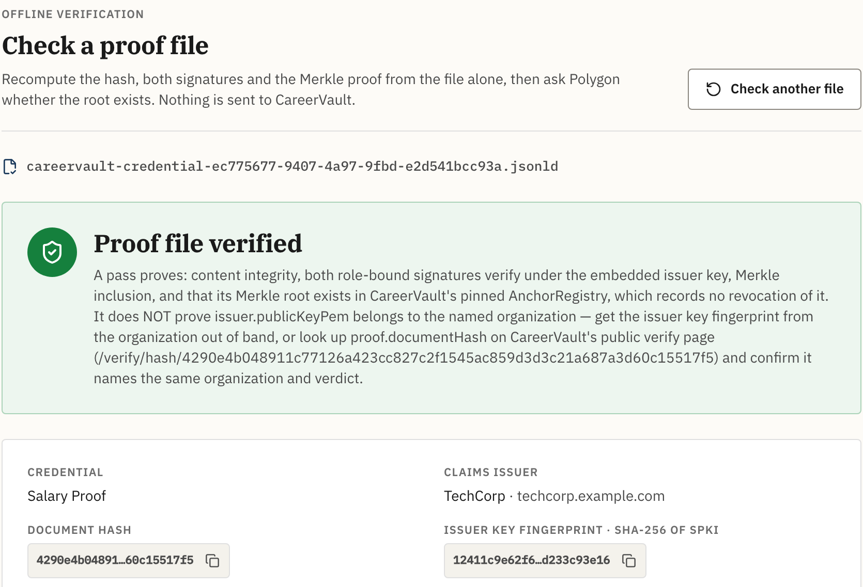
Point 1 · Proof works even if our server is gone
Proof file (.jsonld)
The employee keeps it, like a PDF
Polygon blockchain
Public, anyone can read it
Verifier's browser or laptop → VALID
Recomputes hash, both signatures, Merkle proof
CareerVault server + database: NOT needed
eLocker: trust their server. CareerVault: trust maths + a public blockchain.
Notes:
The employee downloads a proof file. To check it you need only two things: that file and the public Polygon blockchain. Our server and database are not used at all. The screenshot on the right is the real checker: it says "No CareerVault API was called". eLocker needs you to trust their server. We need you to trust maths and a public blockchain.

Slide 5
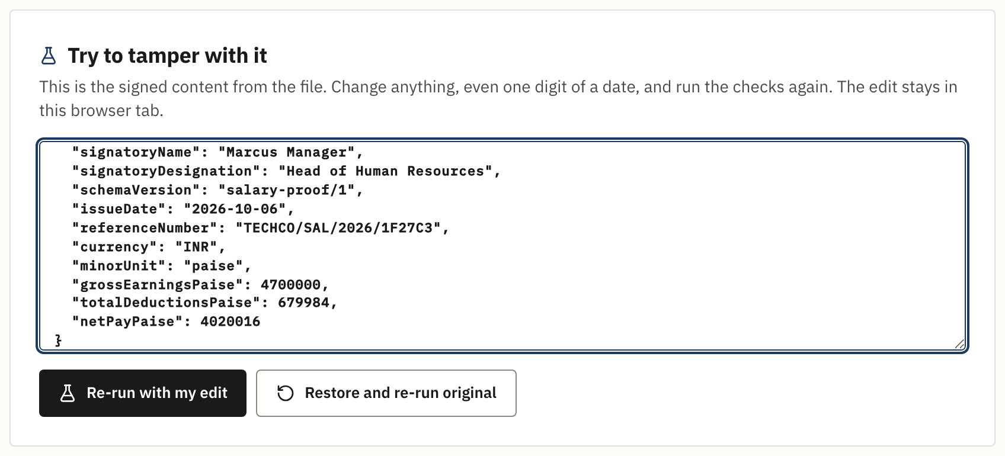
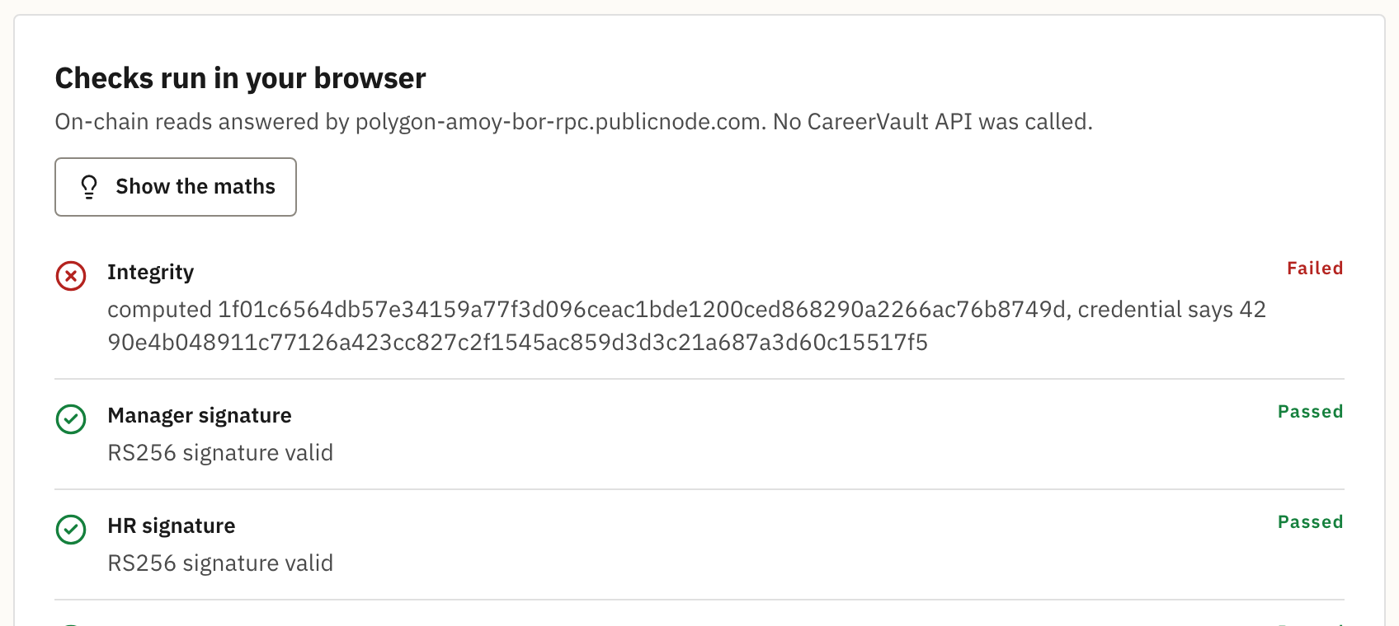
Point 1 · Change one word, and it fails
Step 1: change "Intern" to "CEO" in the file
Step 2: re-run: Integrity FAILED
Any edit changes the SHA-256 hash, so the fake is caught at once.
Notes:
Live demo: on the proof-file page we change the designation from Intern to CEO and run the checks again. Integrity fails immediately: the computed hash no longer matches the signed hash. The signatures still pass because they signed the original hash, which proves exactly what was changed.

Slide 6
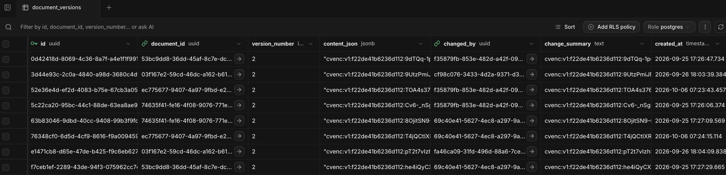
Point 2 · Database now stores only locked data
BEFORE: anyone with DB access could read it
{"designation": "Intern", "basicPaise": 3000000, ...}
NOW: unreadable without our secret key
"cvenc:v1:f22de41b6236d112:9dTQq-1p..."
Real screenshot: Supabase → CareerVault (PRODUCTION) → document_versions. Every row is locked.
Notes:
Last time the content column was readable JSON. Now the server encrypts it before saving, so the database only holds "cvenc:v1:..." text. The screenshot is our real production Supabase table, document_versions: content_json and change_summary are locked on every row. Without our secret key this is useless. Live: open Supabase, Table Editor, documents or document_versions.

Slide 7
Point 2 · How the lock works
1
2
3
4
Master key
Secret on the server only (KMS_MASTER_KEY). Never in the DB.
New key per row
A fresh random key for every document
AES-256-GCM
Locks each field; any change breaks the lock
Supabase
Stores only "cvenc:v1:..." text
Locked columns
content_json, salt, both signatures, revocation reason, change_summary, issued PDFs. Unlocked automatically when the app reads.
Extra layer (Supabase)
The whole database disk is also encrypted (AES-256), and connections use TLS.
Notes:
There is one master key. It lives only on the server as a secret setting, never in the database or GitHub. For every row the server makes a fresh random key, locks the fields with AES-256-GCM, and stores only the locked text. When the app reads a row, a Prisma extension unlocks it automatically, so the app works the same. On top of that, Supabase encrypts the whole disk with AES-256 and uses TLS.

Slide 8
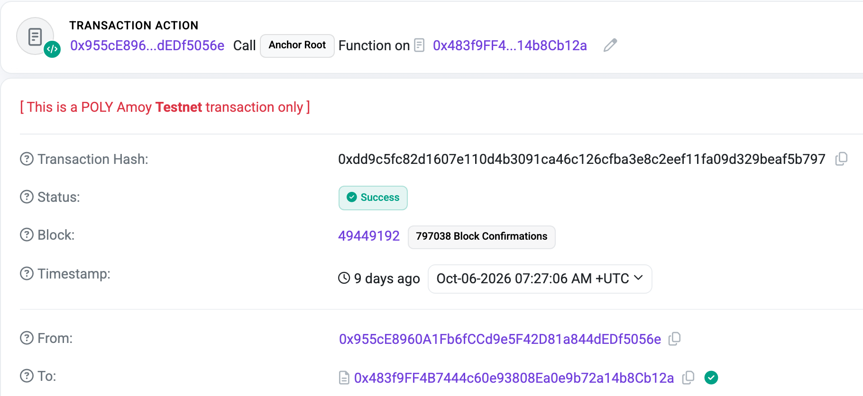
Point 3 · Real blockchain: Polygon Amoy, no simulation
1
Collect all newly issued documents
2
Build a Merkle tree → 1 root (32 bytes)
3
Our wallet calls anchorRoot(root) on our contract
4
Polygon confirms the transaction
5
Transaction hash saved in our database
Contract 0x483f9FF4…4b8Cb12a · chain 80002
Notes:
Every night at midnight, or when the admin clicks Anchor now: we collect issued documents, build a Merkle tree, and our wallet sends the root to our smart contract on Polygon Amoy. We wait for confirmation and save the transaction hash in our database. The screenshot is the real transaction on PolygonScan: status Success, function Anchor Root, from our wallet to our contract.

Slide 9
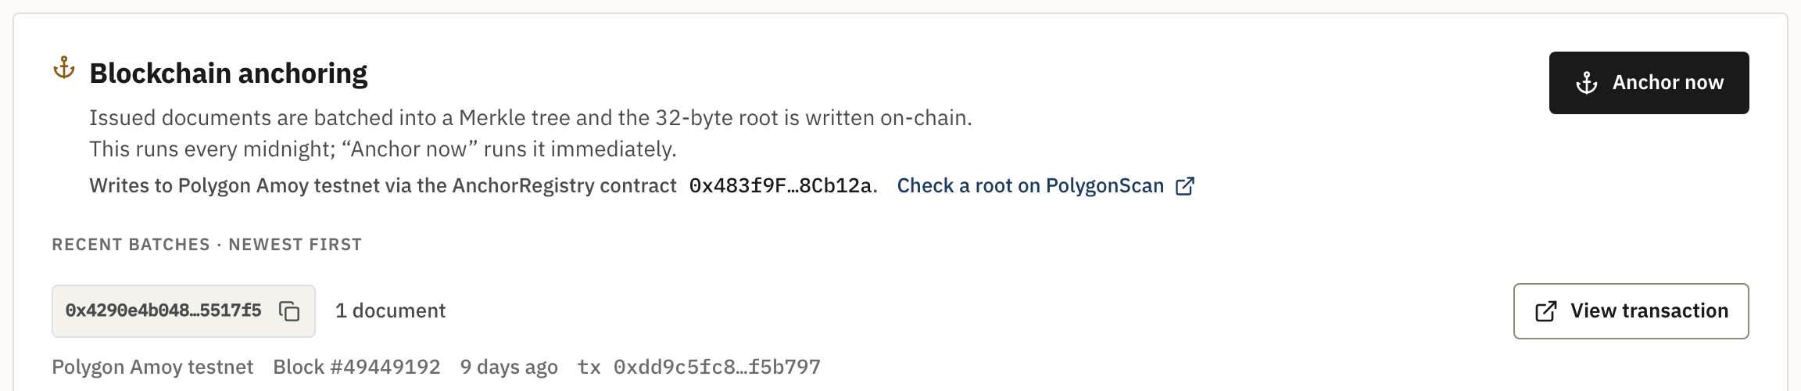
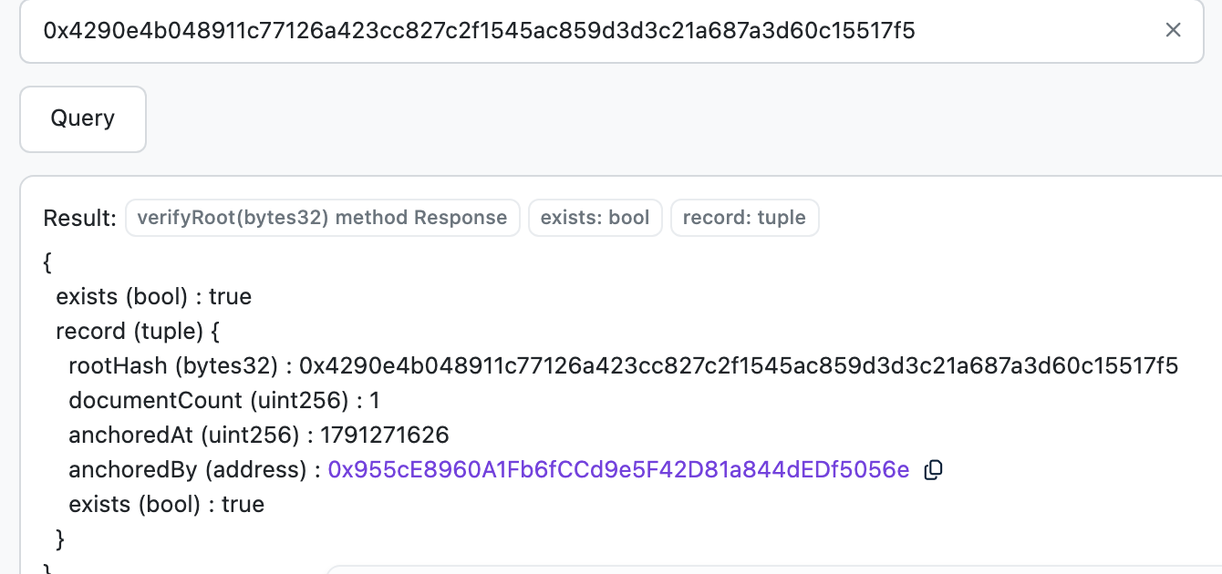
Point 3 · Anyone can check it on PolygonScan
1. Admin clicks "Anchor now"
2. PolygonScan → verifyRoot → exists = true
Result: the root is written to our contract and the batch links to the transaction.
This answer comes from the Polygon blockchain, not from CareerVault. Anyone in the world can check it.
Notes:
Left: the admin screen with the Anchor now button and the list of batches. Right: on PolygonScan we paste the root into verifyRoot and click Query. It answers exists = true, with the time and our wallet. That answer comes from the blockchain itself, not from our server.

Slide 10
Point 4 · The hashing pipeline in 5 steps
document_hash = SHA-256( JCS(content) + salt )
1
2
3
4
5
JCS
Sort keys, fixed format (RFC 8785)
Add salt
32 random bytes, added at the end
SHA-256
64-character fingerprint
RSA-2048
Manager signs, then HR signs
Merkle root
Many hashes → 1 root → Polygon
{"basicPaise":…}
c3d61d70…f0fcb
4290e4b0…17f5
2 signatures (RS256)
tx 0xdd9c5fc8…
Order: steps 1–4 happen when the document is signed; step 5 happens later in a batch.
Notes:
Step 1 JCS: sort the keys so the same data always becomes the same text. Step 2: add 32 random bytes of salt at the end. Step 3: SHA-256 gives the 64-character fingerprint. Step 4: the manager and HR each sign with TechCorp's RSA-2048 key, at the moment they click. Step 5: at midnight or Anchor now, many hashes become one Merkle root that goes on Polygon. The grey values are real, from Alice's anchored salary proof.

Slide 11
Point 4 · Why each step exists
1 JCS
The same data must always give the same text, and so the same hash
2 Salt
Nobody can guess a salary from the public hash. Deleting the salt = GDPR "right to erase"
3 SHA-256
Change one letter and the hash changes completely, so tampering is obvious
4 RSA-2048
Proves TechCorp's manager AND HR approved it. Each signs their own role statement
5 Merkle root
One blockchain transaction covers many documents; only 32 bytes, no personal data
Notes:
If they ask why: JCS so the same data always gives the same hash. Salt so nobody can guess a salary from the public hash, and deleting the salt is our GDPR erase. SHA-256 so one changed letter gives a totally different hash. RSA so we know TechCorp's manager and HR really approved it. Merkle so one cheap transaction covers many documents and no personal data goes on-chain.

Slide 12
Summary: all 4 points are live
POINT
STATUS
SHOW IT LIVE
1
Works without our server
Download proof file → /verify/file → tamper test
DONE
2
Encrypted database
Supabase → documents → content_json = "cvenc:v1:…"
DONE
3
Real Polygon blockchain
Admin → Anchor now → PolygonScan → verifyRoot
DONE
4
Hashing pipeline
JCS → salt → SHA-256 → RSA → Merkle root
DONE
Notes:
All four are done and running on the deployed site. Now we show it live, in this order: issue a document, show the encrypted row in Supabase, anchor it on Polygon, then verify the downloaded file without our server.

Slide 13
Thank you
Questions, then live demo
Notes:
Thank you. Happy to take questions, or go straight into the live demo.

